Slide 1

2025 PRC Community Health Needs Assessment
Monterey County, California
Bruce Lockwood
Senior Vice President, Community Health

Slide 2









Slide 3


About Today’s Event
All attendees will be in listen-only mode.
However, you can use the “Questions” section of the dashboard to type in questions at any time, and these will be addressed at the end of the data presentation.
This presentation will include opportunities to get feedback from you.
To do this, you will need to use a separate mobile device to participate (or access a second screen/window with a web browser).

Slide 4


Community Health Needs Assessment
The PRC Community Health Needs Assessment consists of both primary and secondary data.
BENCHMARKING
Previous Survey Data (2022)
PRC National Health Survey
California BRFSS data
Healthy People 2030 targets
National vital statistics data
Secondary Data
County-level data
Census data, vital statistics, other health-related data
Online Key Informant Survey
Community stakeholder input — 96 physicians, public health, other health providers, social services, community leaders
Based on their experiences, the populations they serve
Customized Local Health Survey
Population-based, stratified by hospital service area
Targets health status, experience, behaviors
Conducted via landline/cell phones and internet-based surveys

Slide 5
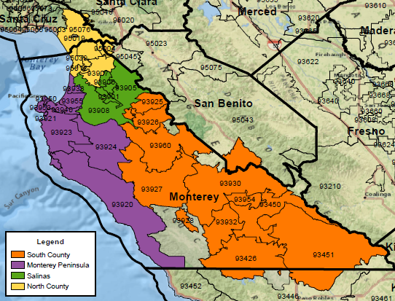
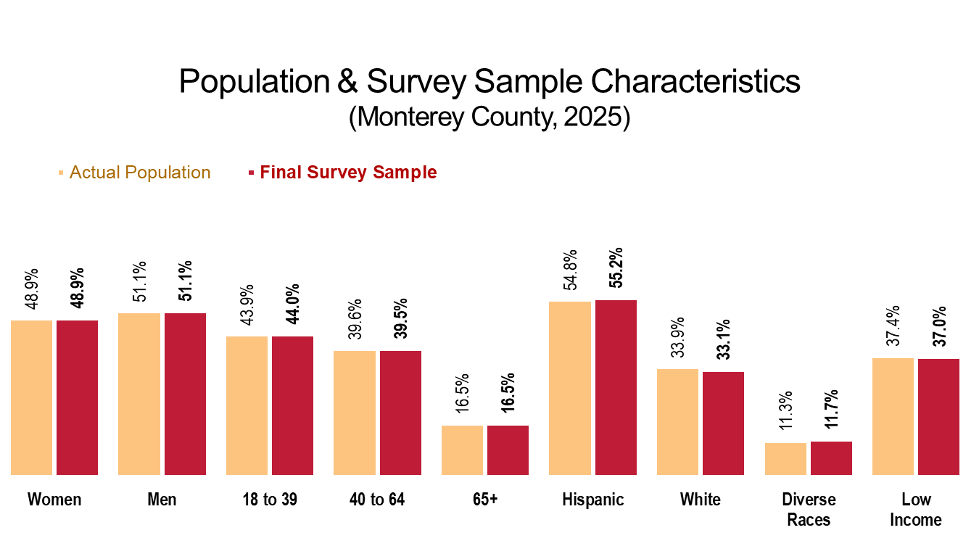
Population Survey
3,005 surveys completed across Monterey County:
396 in South County
1,583 in Monterey Peninsula
792 in Salinas
234 in North County
Total sample size gives an overall maximum confidence interval of ±1.8%.
Over 100 survey items; 20-25 minute interview.
Final sample weighted in proportion to total population

Slide 6
Today’s Activities
Presentation
Represents just a fraction of the data collected through this assessment.
Primarily focuses on areas of need ("Areas of Opportunity"); however, there were many positive findings for the area as well.
Will allow for Q&A at the end.
Prioritization
During the second part of our meeting, you will be asked to rank health issues along various criteria to inform the prioritization process.

Slide 7
Key Informant Input

Slide 8
Key Informant Perceptions: Relative Position of Health Topics as Problems in Monterey County

Slide 9
General Health Status
Areas of Opportunity
Access to Health Care Services
Cancer
Diabetes
Heart Disease & Stroke
Housing
Infant Health & Family Planning
Injury & Violence
Mental Health
Nutrition, Physical Activity & Weight
Respiratory Disease
Substance Use
Tobacco Use
Q & A
12 “Areas of Opportunity” (significant health needs)

Slide 10
General Health Status
Areas of Opportunity
Access to Health Care Services
Cancer
Diabetes
Heart Disease & Stroke
Housing
Infant Health & Family Planning
Injury & Violence
Mental Health
Nutrition, Physical Activity & Weight
Respiratory Disease
Substance Use
Tobacco Use
Q & A

Slide 11
Self-Reported Health Status (Monterey County, 2025)
Sources: ● 2025 PRC Community Health Survey, PRC, Inc. [Item 4]
Notes: ● Asked of all respondents.

Slide 12
Experience “Fair” or “Poor” Overall Health
Monterey County
Sources: ● 2025 PRC Community Health Survey, PRC, Inc. [Item 4]
● Behavioral Risk Factor Surveillance System Survey Data. Atlanta, Georgia. United States Department of Health and Human Services, Centers for Disease Control and Prevention (CDC): 2023 California data.
● 2023 PRC National Health Survey, PRC, Inc.
Notes: ● Asked of all respondents.
Notes:
NOTE that even these subareas of the county are fairly broad geographies. For example, while the Monterey Peninsula area fares better here as a whole, the Peninsula can be further subdivided into smaller subareas where findings for some communities — like Marina and Seaside — are often not nearly as favorable. And not just for this chart, but some others we’ll talk about today, such as food insecurity, mental health, diabetes and overweight/obesity.

Slide 13
Experience “Fair” or “Poor” Overall Health (Monterey County, 2025)
Sources: ● 2025 PRC Community Health Survey, PRC, Inc. [Item 4]
Notes: ● Asked of all respondents.

Slide 14
General Health Status
Areas of Opportunity
Access to Health Care Services
Cancer
Diabetes
Heart Disease & Stroke
Housing
Infant Health & Family Planning
Injury & Violence
Mental Health
Nutrition, Physical Activity & Weight
Respiratory Disease
Substance Use
Tobacco Use
Q & A

Slide 15
Lack of Health Care Insurance Coverage (Adults 18-64; Monterey County, 2025) Healthy People 2030 = 7.6% or Lower
Sources: ● 2025 PRC Community Health Survey, PRC, Inc. [Item 117]
● US Department of Health and Human Services. Healthy People 2030. https://health.gov/healthypeople
Notes: ● Reflects respondents age 18 to 64.

Slide 16
Barriers to Access Have Prevented Medical Care in the Past Year
has improved since 2022
has improved since 2022
has improved since 2022
has improved since 2022
Sources: ● 2025 PRC Community Health Survey, PRC, Inc. [Items 6-13]
● 2023 PRC National Health Survey, PRC, Inc.
Notes: ● Asked of all respondents.

Slide 17
Experienced Difficulties or Delays of Some Kind in Receiving Needed Health Care in the Past Year
Higher among women and those under the age of 65.
Monterey County
Sources: ● 2025 PRC Community Health Survey, PRC, Inc. [Item 119]
● 2023 PRC National Health Survey, PRC, Inc.
Notes: ● Asked of all respondents.
● Percentage represents the proportion of respondents experiencing one or more barriers to accessing health care in the past 12 months.

Slide 18
Have Used a Hospital Emergency Room More Than Once in the Past Year (Monterey County, 2025)
Monterey County
Sources: ● 2025 PRC Community Health Survey, PRC, Inc. [Item 19]
Notes: ● Asked of all respondents.
At the same time, we’ve seen a decrease in the percentage of residents with a particular doctor or clinic they go to for health care (64.7%), now below the national prevalence (69.9%).

Slide 19
General Health Status
Areas of Opportunity
Access to Health Care Services
Cancer
Diabetes
Heart Disease & Stroke
Housing
Infant Health & Family Planning
Injury & Violence
Mental Health
Nutrition, Physical Activity & Weight
Respiratory Disease
Substance Use
Tobacco Use
Q & A

Slide 20
Leading Causes of Death (Monterey County, 2023)
Sources: ● CDC WONDER Online Query System. Centers for Disease Control and Prevention, Epidemiology Program Office, Division of Public Health Surveillance and Informatics. Data extracted July 2025.
Notes: ● Lung disease includes deaths classified as chronic lower respiratory disease.

Slide 21
Select Cancer Screening Indicators
Breast Cancer Screening
(Women 40-74) Healthy People 2030 = 80.5% or Higher
Cervical Cancer Screening
(Women 21-65) Healthy People 2030 = 84.3% or Higher
Colorectal Cancer Screening
(All Adults 45-75) Healthy People 2030 = 74.4% or Higher
A decrease from 82.6% in 2022.
A decrease from 79.1% in 2022.
Sources: ● 2025 PRC Community Health Survey, PRC, Inc. [Items 101-103]
● 2023 PRC National Health Survey, PRC, Inc.
● US Department of Health and Human Services. Healthy People 2030. https://health.gov/healthypeople
Notes: ● Each indicator is shown among the gender and/or age group specified.
● * Note that national data for breast cancer screening reflect women ages 50 to 74. National data for colorectal cancer screening reflect adults ages 50 to 75.

Slide 22
General Health Status
Areas of Opportunity
Access to Health Care Services
Cancer
Diabetes
Heart Disease & Stroke
Housing
Infant Health & Family Planning
Injury & Violence
Mental Health
Nutrition, Physical Activity & Weight
Respiratory Disease
Substance Use
Tobacco Use
Q & A

Slide 23
Prevalence of Diabetes (Monterey County, 2025)
Sources: ● 2025 PRC Community Health Survey, PRC, Inc. [Items 106, 309]
Notes: ● Asked of all respondents.
● Excludes gestational diabetes (occurring only during pregnancy).
Another 19.0% of adults have been diagnosed with
“pre-diabetes” or “borderline” diabetes (an increase since 2022 and higher than the US prevalence of 15.0%).

Slide 24
Kidney Disease Mortality Trends (Annual Average Deaths per 100,000 Population)
Sources: ● CDC WONDER Online Query System. Centers for Disease Control and Prevention, Epidemiology Program Office, Division of Public Health Surveillance and Informatics. Data extracted July 2025.
Notes: ● Deaths are coded using the Tenth Revision of the International Statistical Classification of Diseases and Related Health Problems (ICD-10).
● Rates are per 100,000 population.

Slide 25
General Health Status
Areas of Opportunity
Access to Health Care Services
Cancer
Diabetes
Heart Disease & Stroke
Housing
Infant Health & Family Planning
Injury & Violence
Mental Health
Nutrition, Physical Activity & Weight
Respiratory Disease
Substance Use
Tobacco Use
Q & A

Slide 26
Leading Causes of Death (Monterey County, 2023)
Sources: ● CDC WONDER Online Query System. Centers for Disease Control and Prevention, Epidemiology Program Office, Division of Public Health Surveillance and Informatics. Data extracted July 2025.
Notes: ● Lung disease includes deaths classified as chronic lower respiratory disease.
Note that stroke mortality rates, although below CA and US levels, have risen over the past decade.

Slide 27
Prevalence of Heart Disease
Prevalence of Stroke
Monterey County
Monterey County
Age 65+ = 25.1%
Age 65+ = 5.3%
Sources: ● 2025 PRC Community Health Survey, PRC, Inc. [Item 23]
● Behavioral Risk Factor Surveillance System Survey Data. Atlanta, Georgia. United States Department of Health and Human Services, Centers for Disease Control and Prevention (CDC): 2023 California data.
● 2023 PRC National Health Survey, PRC, Inc.
Notes: ● Asked of all respondents.

Slide 28
Prevalence of
High Blood Pressure Healthy People 2030 = 42.6% or Lower
Prevalence of
High Blood Cholesterol
Sources: ● 2025 PRC Community Health Survey, PRC, Inc. [Items 29-30]
● Behavioral Risk Factor Surveillance System Survey Data. Atlanta, Georgia. United States Department of Health and Human Services, Centers for Disease Control and Prevention (CDC): 2023 California data.
● 2023 PRC National Health Survey, PRC, Inc.
● US Department of Health and Human Services. Healthy People 2030. https://health.gov/healthypeople
Notes: ● Asked of all respondents.

Slide 29
General Health Status
Areas of Opportunity
Access to Health Care Services
Cancer
Diabetes
Heart Disease & Stroke
Housing
Infant Health & Family Planning
Injury & Violence
Mental Health
Nutrition, Physical Activity & Weight
Respiratory Disease
Substance Use
Tobacco Use
Q & A

Slide 30
Frequency of Worry/Stress About Paying Rent/Mortgage in Past Year (Monterey County, 2025)
“Always/Usually/Sometimes” Worried About Paying Rent/Mortgage in Past Year
(Monterey County)
Sources: ● 2025 PRC Community Health Survey, PRC, Inc. [Item 56]
Notes: ● Asked of all respondents.

Slide 31
“Always/Usually/Sometimes” Worried About Paying Rent/Mortgage in the Past Year (Monterey County, 2025)
Among homeowners 28.0%
Among renters 62.5%
Sources: ● 2025 PRC Community Health Survey, PRC, Inc. [Item 56]
Notes: ● Asked of all respondents.
Geographically, highest in the Salinas area.

Slide 32
Unhealthy or Unsafe Housing Conditions in the Past Year (Monterey County, 2025)
Among homeowners 15.3%
Among renters 25.1%
Sources: ● 2025 PRC Community Health Survey, PRC, Inc. [Item 55]
Notes: ● Asked of all respondents.
● Includes respondents who say they experienced ongoing problems in their current home with water leaks, rodents, insects, mold, or other housing conditions that might make living there unhealthy or unsafe.

Slide 33
General Health Status
Areas of Opportunity
Access to Health Care Services
Cancer
Diabetes
Heart Disease & Stroke
Housing
Infant Health & Family Planning
Injury & Violence
Mental Health
Nutrition, Physical Activity & Weight
Respiratory Disease
Substance Use
Tobacco Use
Q & A
Notes:
Just one slide to share here…

Slide 34
Teen Birth Rate by Race/Ethnicity (Births to Females Age 15-19 per 1,000 Females Age 15-19; Monterey County, 2017-2023)
Sources: ● Centers for Disease Control and Prevention, National Vital Statistics System.
● Center for Applied Research and Engagement Systems (CARES), University of Missouri Extension. Retrieved July 2025 via SparkMap (sparkmap.org).
Notes: ● This indicator reports the rate of total births to women under the age of 15-19 per 1,000 female population age 15-19.
● Race categories reflect individuals without Hispanic origin.

Slide 35
General Health Status
Areas of Opportunity
Access to Health Care Services
Cancer
Diabetes
Heart Disease & Stroke
Housing
Infant Health & Family Planning
Injury & Violence
Mental Health
Nutrition, Physical Activity & Weight
Respiratory Disease
Substance Use
Tobacco Use
Q & A

Slide 36
Unintentional Injury Mortality Trends (Annual Average Deaths per 100,000 Population) Healthy People 2030 = 43.2 or Lower
Leading Causes of Unintentional Injury Deaths (Monterey County, 2021-2023)
Sources: ● CDC WONDER Online Query System. Centers for Disease Control and Prevention, Epidemiology Program Office, Division of Public Health Surveillance and Informatics. Data extracted July 2025.

Slide 37
Have Ever Been Hit, Slapped, Pushed, Kicked, or Hurt in Any Way by an Intimate Partner
Monterey County
Sources: ● 2025 PRC Community Health Survey, PRC, Inc. [Item 33]
● 2023 PRC National Health Survey, PRC, Inc.
Notes: ● Asked of all respondents.

Slide 38
General Health Status
Areas of Opportunity
Access to Health Care Services
Cancer
Diabetes
Heart Disease & Stroke
Housing
Infant Health & Family Planning
Injury & Violence
Mental Health
Nutrition, Physical Activity & Weight
Respiratory Disease
Substance Use
Tobacco Use
Q & A

Slide 39
Select Mental Health Indicators
Experience “Fair” or “Poor” Mental Health
Diagnosed With a Depressive Disorder
Typical Day Is “Extremely” or “Very” Stressful
Better than US (30.8%)
Worse than US (24.4%)
At greater risk are: women, younger adults, those with lower incomes, Hispanic residents, LGBTQ+ residents.
Sources: ● 2025 PRC Community Health Survey, PRC, Inc.

Slide 40
Unable to Get Mental Health Services When Needed in the Past Year (Monterey County, 2025)
Sources: ● 2025 PRC Community Health Survey, PRC, Inc. [Item 82]
Notes: ● Asked of all respondents.

Slide 41
Aware of Mental Health Resources for Children (Parents of Children Age 5-17, 2025)
Monterey County
Sources: ● 2025 PRC Community Health Survey, PRC, Inc. [Item 322]
● 2023 PRC National Child & Adolescent Health Survey, PRC, Inc.
Notes: ● Asked of all respondents with children age 5 through 17.

Slide 42
General Health Status
Areas of Opportunity
Access to Health Care Services
Cancer
Diabetes
Heart Disease & Stroke
Housing
Infant Health & Family Planning
Injury & Violence
Mental Health
Nutrition, Physical Activity & Weight
Respiratory Disease
Substance Use
Tobacco Use
Q & A

Slide 43
Prevalence of Total Overweight (Overweight and Obese)
Prevalence of Obesity Healthy People 2030 = 36.0% or Lower
Sources: ● 2025 PRC Community Health Survey, PRC, Inc. [Item 112]
● Behavioral Risk Factor Surveillance System Survey Data. Atlanta, Georgia. United States Department of Health and Human Services, Centers for Disease Control and Prevention (CDC): 2023 California data.
● 2023 PRC National Health Survey, PRC, Inc.
Notes: ● Based on reported heights and weights, asked of all respondents.
● The definition of overweight is having a body mass index (BMI), a ratio of weight to height (kilograms divided by meters squared), greater than or equal to 25.0,. The definition for obesity is a BMI greater than or equal to 30.0.

Slide 44
Prevalence of Obesity (Monterey County, 2025) Healthy People 2030 = 36.0% or Lower
Sources: ● 2025 PRC Community Health Survey, PRC, Inc. [Item 112]
● US Department of Health and Human Services. Healthy People 2030. https://health.gov/healthypeople
Notes: ● Based on reported heights and weights, asked of all respondents.
● The definition of obesity is having a body mass index (BMI), a ratio of weight to height (kilograms divided by meters squared), greater than or equal to 30.0, regardless of gender.

Slide 45
Prevalence of Overweight/Obesity in Children (Children 5-17)
Monterey County
Includes 25.8% who are obese.
Sources: ● 2025 PRC Community Health Survey, PRC, Inc. [Item 113]
● 2023 PRC National Health Survey, PRC, Inc.
Notes: ● Asked of all respondents with children age 5-17 at home.
● Overweight among children is determined by children’s Body Mass Index status at or above the 85th percentile of US growth charts by gender and age.

Slide 46
Adults: Meet Physical Activity Recommendations Healthy People 2030 = 29.7% or Higher
Children: Meet Physical Activity Recommendations (Children 2-17)
Sources: ● 2025 PRC Community Health Survey, PRC, Inc. [Item 110]
● Behavioral Risk Factor Surveillance System Survey Data. Atlanta, Georgia. United States Department of Health and Human Services, Centers for Disease Control and Prevention (CDC): 2023 California data.
● 2023 PRC National Health Survey, PRC, Inc.
● US Department of Health and Human Services. Healthy People 2030. https://health.gov/healthypeople
Percentages for both adults and children have improved in Monterey County since 2022.

Slide 47
General Health Status
Areas of Opportunity
Access to Health Care Services
Cancer
Diabetes
Heart Disease & Stroke
Housing
Infant Health & Family Planning
Injury & Violence
Mental Health
Nutrition, Physical Activity & Weight
Respiratory Disease
Substance Use
Tobacco Use
Q & A
Notes:
Just one slide to share here…

Slide 48
Prevalence of Asthma in Children (Children 0-17)
Monterey County
Sources: ● 2025 PRC Community Health Survey, PRC, Inc. [Item 92]
● 2023 PRC National Health Survey, PRC, Inc.
Notes: ● Asked of all respondents with children age 0 to 17 in the household.

Slide 49
General Health Status
Areas of Opportunity
Access to Health Care Services
Cancer
Diabetes
Heart Disease & Stroke
Housing
Infant Health & Family Planning
Injury & Violence
Mental Health
Nutrition, Physical Activity & Weight
Respiratory Disease
Substance Use
Tobacco Use
Q & A

Slide 50
Alcohol-Induced Mortality (Annual Average Deaths per 100,000 Population)
Unintentional Drug-Induced Mortality (Annual Average Deaths per 100,000 Population)
Sources: ● CDC WONDER Online Query System. Centers for Disease Control and Prevention, Epidemiology Program Office, Division of Public Health Surveillance and Informatics. Data extracted July 2025.
Notes: ● Deaths are coded using the Tenth Revision of the International Statistical Classification of Diseases and Related Health Problems (ICD-10).
● Rates are per 100,000 population.
Notes:
…Recall from earlier that “poisoning, including drug overdoses” were the leading cause of all unintentional deaths in Monterey County.

Slide 51
Engage in Excessive Drinking
Used an Illicit Drug in Past Month
A decrease from 25.6% in 2022.
A decrease from 6.1% in 2022.
Sources: ● 2025 PRC Community Health Survey, PRC, Inc.
Notes: ● Asked of all respondents.
5.0% of all county adults have ever sought help for a substance use issue (US=6.8%).

Slide 52
Life Has Been Negatively Affected by Substance Use (by Self or Someone Else) (Monterey County, 2025)
Sources: ● 2025 PRC Community Health Survey, PRC, Inc. [Item 43]
Notes: ● Asked of all respondents.
● Includes those responding “a great deal,” “somewhat,” or “a little.”

Slide 53
General Health Status
Areas of Opportunity
Access to Health Care Services
Cancer
Diabetes
Heart Disease & Stroke
Housing
Infant Health & Family Planning
Injury & Violence
Mental Health
Nutrition, Physical Activity & Weight
Respiratory Disease
Substance Use
Tobacco Use
Q & A

Slide 54
Currently Smoke Cigarettes Healthy People 2030 = 6.1% or Lower
Currently Use Vaping Products (Monterey County, 2025)
Much better than US (23.9%)
Much better than US (18.5%)
Sources: ● 2025 PRC Community Health Survey, PRC, Inc. [Item 34]
● Behavioral Risk Factor Surveillance System Survey Data. Atlanta, Georgia. United States Department of Health and Human Services, Centers for Disease Control and Prevention (CDC): 2023 California data.
● 2023 PRC National Health Survey, PRC, Inc.
● US Department of Health and Human Services. Healthy People 2030. https://health.gov/healthypeople
Notes: ● Asked of all respondents.
● Includes those who smoke cigarettes every day or on some days.

Slide 55
Currently Use Vaping Products (Monterey County, 2025)
In the past 30 days, I vaped:
Tobacco/nicotine 37.0%
Cannabis/THC 32.7%
Both 30.3%
Sources: ● 2025 PRC Community Health Survey, PRC, Inc. [Item 36]
Notes: ● Asked of all respondents.
● Includes those who use vaping products every day or on some days.

Slide 56
General Health Status
Areas of Opportunity
Access to Health Care Services
Cancer
Diabetes
Heart Disease & Stroke
Housing
Infant Health & Family Planning
Injury & Violence
Mental Health
Nutrition, Physical Activity & Weight
Respiratory Disease
Substance Use
Tobacco Use
Q & A

Slide 57
Prioritization Results

Slide 58
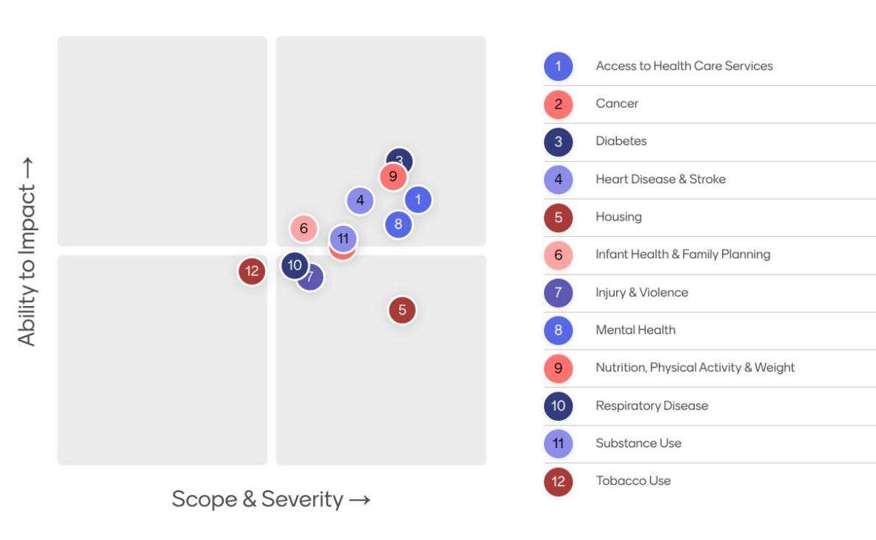
On October 7, 2025, the Monterey County Health Needs Collaborative convened an online meeting attended by 116 local providers and other community leaders (representing a cross-section of community-based agencies and organizations) to evaluate, discuss, and prioritize health issues for the community.
Their input through a prioritization exercise yielded the following:

Slide 59




Thank You!
www.healthymontereycounty.org

